Slide 1
Play to Win

Slide 2
Location Decision Trends
Can I attract, recruit, and retain the talent and expertise to be successful?
There is a “Need for Speed” – sometimes
Must be responsive
Must have product/inventory
Incentives – flexibility Is important “One size does not fit all”
Creative
Performance-based
Front-end loaded
It’s About COST! – Every facet of the location decision process is competitive. Locations must offer a cost-competitive business environment.

Slide 3
Strategic Location Decision – The Process

Slide 4
Strategic Location Drivers
Workforce
Economic Incentives
Cost
Quality of Life
Operating Environment
Accessibility

Slide 5
Sangster’s TOP TEN List
Best Practices to Help Position Your Region to be More Competitive

Slide 6
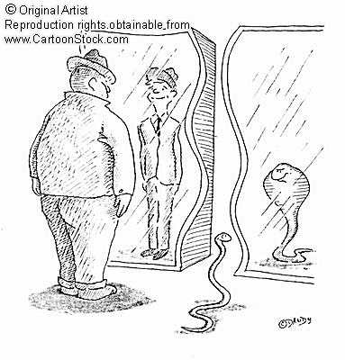
Sangster’s TOP TEN List
10. Don’t pretend to be something that you aren’t
Align local and regional strengths and assets with economic development vision and strategies
Quality jobs mean different things to different communities
What do you want to be when you grow up?

Slide 7
Sangster’s TOP TEN List
9. If you don’t know where you’re going, it’s pretty hard to get there
It’s critical to establish public policies to support your economic development vision
Transportation
Infrastructure
Education
Culture
Perceptions ARE reality- especially negative ones

Slide 8
Sangster’s TOP TEN List
8. Put innovative tools in your toolbox
Offer a variety of innovative incentive tools to meet unique needs of projects
Flexible
Customizable
Streamline application & approval processes

Slide 9
Sangster’s TOP TEN List
7. We’re different- we promise!
Quality of life is NOT a major differentiator
You MUST be able to communicate what differentiates you from your competition
Why Your Community?

Slide 10
Sangster’s TOP TEN List
What is “quality of life” anyway?
Economy rich and diverse enough to provide opportunities for two professional households
Strong K-12 educational opportunities
Environment where housing and income are in equilibrium
Trip to work is a manageable commute
Communities that welcome diversity

Slide 11
Sangster’s TOP TEN List
6. All for one and one for all
(There’s no “I” in team)
Take a regional approach to marketing and promoting your community
The regional organization is MY FRIEND
Everyone wins when the region wins – sounds trite, but it’s true

Slide 12
Sangster’s TOP TEN List
5. If you want to win, you have to have quality players on the team
Assemble a strong team/network of public and private sector members that are advocates for your mission
Engage the team in every aspect of your plan
Strategic planning
Trade missions
Community visits with prospects
“FAM” trips

Slide 13
Sangster’s TOP TEN List
4. Show me the love
Invest in building and maintaining relationships with prospects and those who influence and source projects
Target strategic relationships – everyone has limited resources
Face time is important – building trust and credibility
Get decision-makers to your community

Slide 14
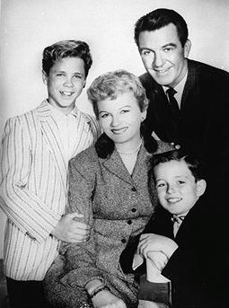
Sangster’s TOP TEN List
3. We’re ONE big, happy family
Take a seamless and integrated approach when coordinating project resources
Regional
Local
State
Utilities
With compressed process and decision times, coordination is critical – can be a filter

Slide 15
Sangster’s TOP TEN List
2. Good information can put you on the map
Invest in developing a superior website
Easy to navigate
Current & accurate information
Maps & visuals
Detailed contact info (who to call)
Personal touch – high level of response with current information

Slide 16
Sangster’s TOP TEN List
1. Become a word in the dictionary… the next
Branding can be a differentiator
One KC
Charlotte USA
Austin- The Human Capital
Target, Target, Target
Strategic advertising
Familiarization tours
Frequent “touches”

