Slide 1
Department of Economic Development
Global Commerce
August 27, 2014

Slide 2
Georgia Department of Economic Development:
WHO WE ARE: The Georgia Department of Economic Development (GDEcD) is the marketing and sales arm of the State of Georgia
WHAT WE DO: Strategically deliver economic development throughout the state by:
Attracting new business investment
Supporting the expansion of existing industry and small businesses
Locating new markets for Georgia products
Attracting tourists from within and outside the state
Promoting Georgia as a desirable location for entertainment businesses and projects

Slide 3
GdecD: Global commerce division
The Global Commerce division assists businesses by coordinating:
Site location services
Market research
Business incentives analysis
Employee training
Innovation and R&D services
Existing industry support
International office assistance

Slide 4
Global Commerce : Team focused / industry specific
Aerospace, Defense & Advanced Manufacturing
Logistics, Energy, Agribusiness, & Food Processing
Health Sciences & Advanced Technologies
Corporate Solutions
International Investment
Existing Industry and Regional Recruitment
International Trade
Centers of Innovation

Slide 5
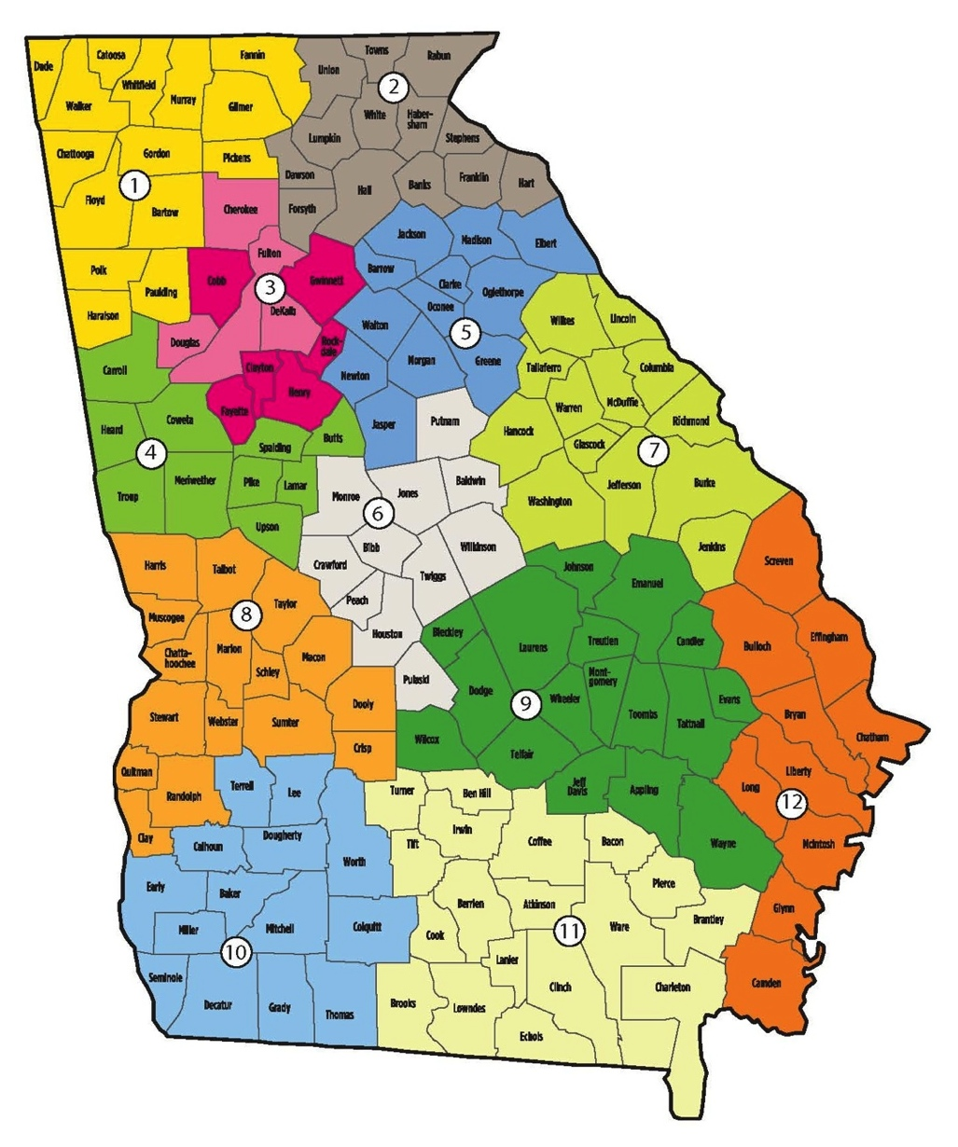
Global Commerce: Statewide Connections
Regional Project Managers
Work with existing companies on expansion projects
Recruit new companies targeted for their region
Provide regional expertise and local connections

Slide 6
GEORGIA’s International representation: 11 Strategic global markets

Slide 7
Industrial recruitment and retention:
> 15,000 U.S. developers vying for limited opportunities
Average project duration is around nine months
50% will be cancelled
25-30% will delay decision
<1/3 received state funds in 2006
60-80% from existing industries

Slide 8
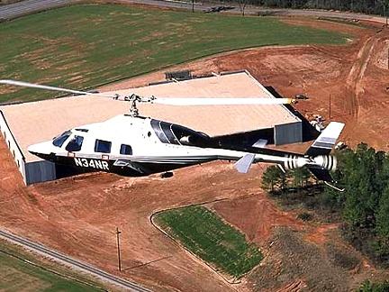
The site location process:
Identify a business need
Consider options
Contact states/communities
Collect/analyze information
Conduct site visits
Begin elimination process
Notes:
Updated 7/24/2014
Southeast:
3 states in SE in the top 10 fastest growing in the nation: SC (10), FL (7), TX (4)
Sources:
GDP: Bureau of Economic Analysis
Population: US Census Bureau

Slide 9
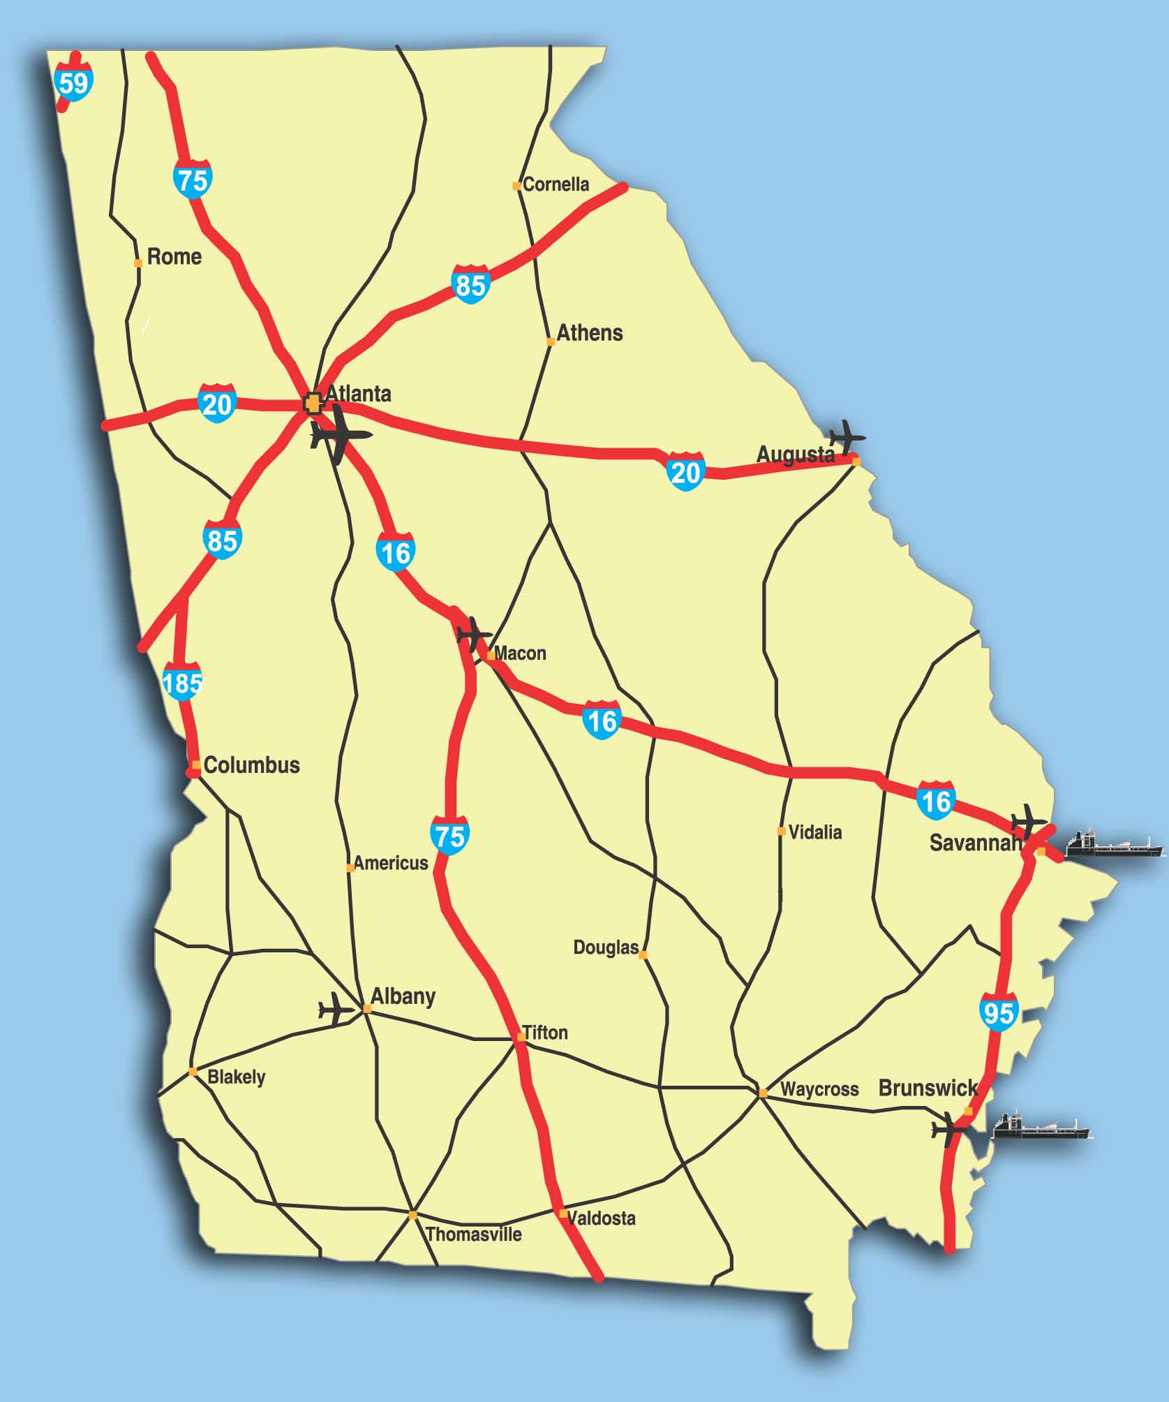
Community Assets:
Location
Sites (20%)
Buildings
Infrastructure
People/workforce
Business environment
Quality of life
Notes:
Added 7/23/14
Southeast:
4 states in SE in the top 10 fastest growing in the nation: GA (7th) and TX (4th), North Carolina (6th), Florida (8th)
Georgia:
Sources:
GDP: Bureau of Economic Analysis
Population: US Census Bureau

Slide 10
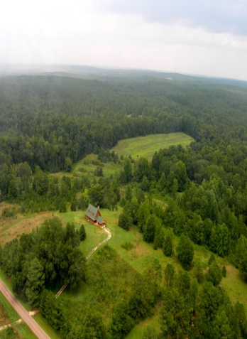
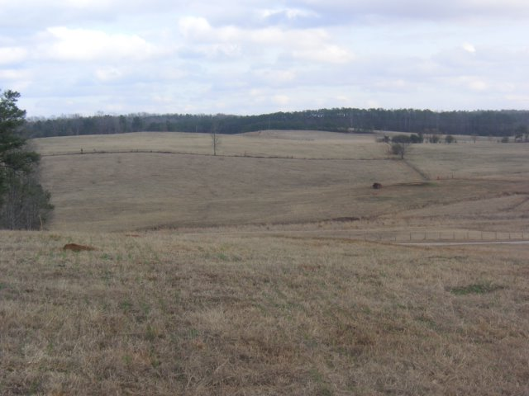
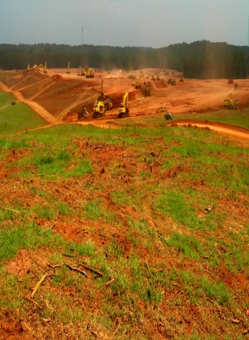
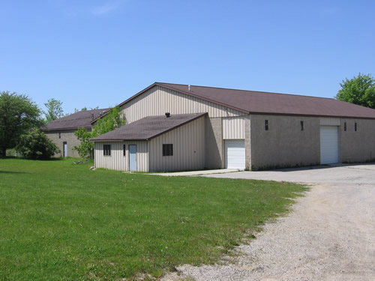
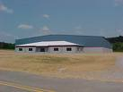
Marketing your community:
Available land/no improvements
Industrial park
Pad ready site
Available building(s)
Spec building(s)
Notes:
Updated 7/24/2014
Southeast:
3 states in SE in the top 10 fastest growing in the nation: SC (10), FL (7), TX (4)
Sources:
GDP: Bureau of Economic Analysis
Population: US Census Bureau

Slide 11
Georgia: ahead in business
Notes:
Added 7/23/14

Slide 12
Today’s project environment:
Compressed timeframe
Moving parameters
Changing technology
Global competition
Site selection functions are outsourced
Varied industry mix (W/D), customer service center and processing
Bottom line: communities must be prepared, flexible and ready to respond quickly
Notes:
Updated 7/25/2014

Slide 13
Partnerships are key:
Communities
Existing industries
State agencies
Utilities and railroads
Education community
Business community
Federal agencies
Notes:
Added 7/23/14

Slide 14
Importance of incentives:
Approve a local incentive policy in advance
Analyze impact of project – LOCI or ReDyn and ensure they are performance-based
Agree and enforce claw-back agreements
Utilize as tie breaker only
The best incentives will not make up for bad business decisions
Incentives should apply to existing industries too

Slide 15
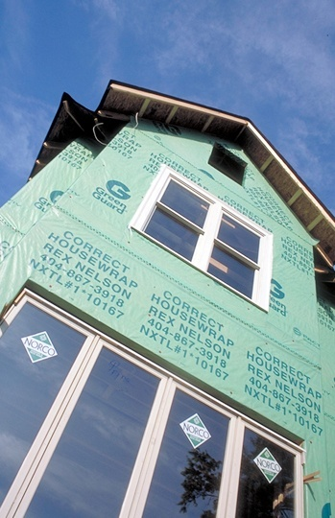
Community incentives:
Land, buildings and infrastructure
Permitting and utilities
Financial assistance
Property tax reductions
Freeport exemptions
Industrial revenue bonds
Beneficial incentives – project specific decisions
Notes:
Updated 7/23/14
Map created by EMC

Slide 16
Georgia state incentives:
Training & hiring
Tax credits – job, investment, etc.
Tax exemptions
HOPE scholarship & grant
Financing
Infrastructure & permitting
Site location facilitation
Site & facility design/engineering
Business plan assistance
Department of Labor
Retraining
Tax Credits
Grants & Scholarships
Notes:
Updated 5/14/13
Map created by EMC

Slide 17
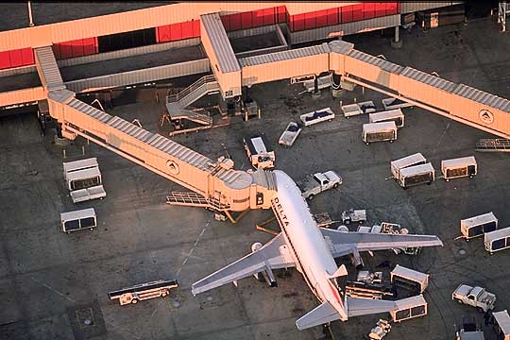
Key community attributes to grow jobs:
Unified pro-business attitude
Pre-determined incentives policy
Diverse economic development plan
Ownership of property and sites
Regional, state and federal partnerships
Awareness of SWOT
Leadership, leadership, leadership
Notes:
Updated 7/23/14

Slide 18
Closing the deal:
The negotiation process – look for win/win
The company’s commitment
The community’s commitment
The state’s commitment
Get it in writing

Slide 19
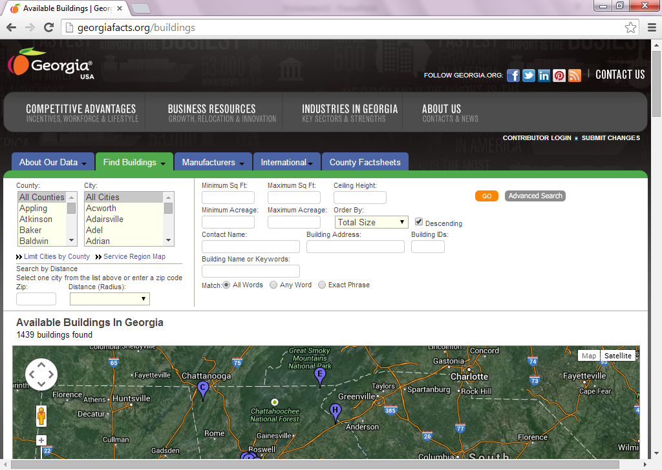
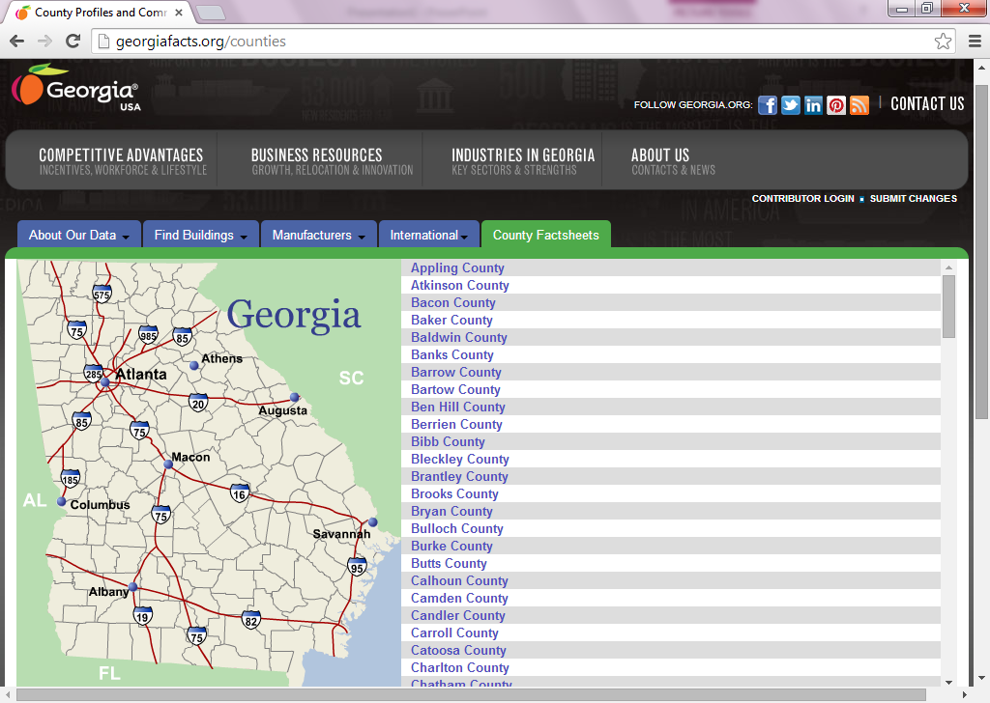
Helpful resources:
Georgiafacts.org
Georgia.org

